Slide 1
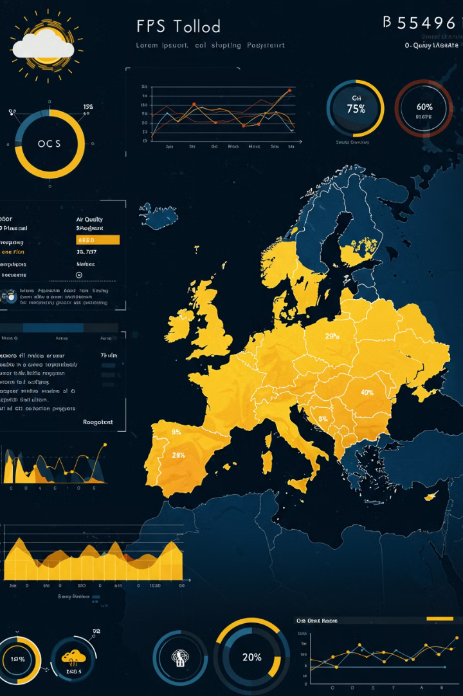
ClimateWins: Weather Prediction and Climate Change Analysis
Project ClimateWins uses machine learning to analyze weather patterns and forecast extreme events. The goal is to improve climate-related decision-making. I project predicts climate trends using historical and real-time weather data. The data is from 18 European weather stations (late 1800s–2022).
Timothy Aluko
TA

Slide 2
Data Cleaning & Preprocessing
Structured Datasets
Feature Engineering
Imputation Techniques
I structured, cleaned, and normalized datasets using Python. Pandas and NumPy were used.
I engineered climate features for model training. These features help improve model accuracy.
I identified missing data points and applied imputation techniques. This ensures data completeness.

Slide 3
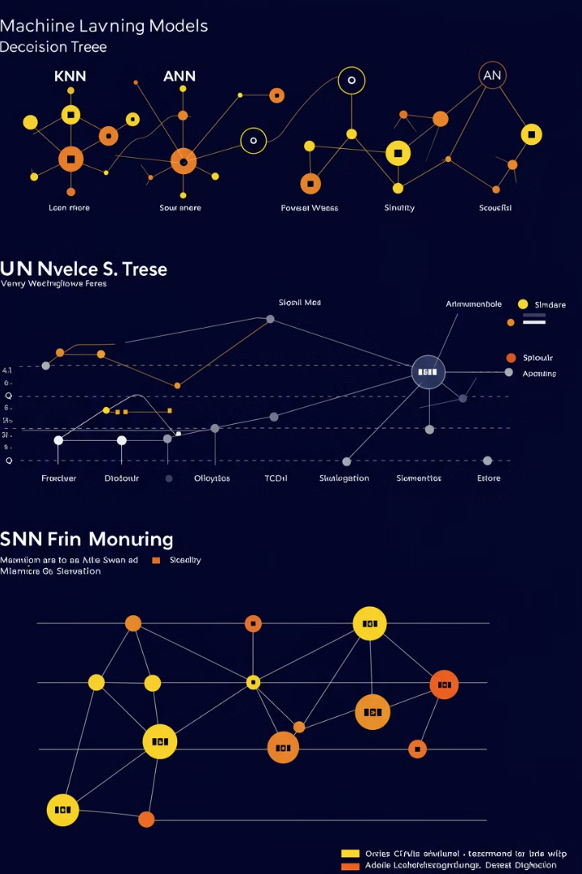



Machine Learning Models Applied
K-Nearest Neighbor
Decision Tree
Artificial Neural Network
This predicts weather trends using multiple environmental variables.
KNN used to classifies weather conditions based on similarity to past patterns.
ANN detects complex climate patterns, improving forecasting accuracy.

Slide 4




Model Optimization & Performance Evaluation
Gradient Descent
I adjusted key parameters for reduced error. Learning rate and iterations are key.
Overfitting Detection
Cross-validation techniques were used to generalize models.
Confusion Matrices
I measured effectiveness in predicting extreme weather events using accuracy scores.

Slide 5
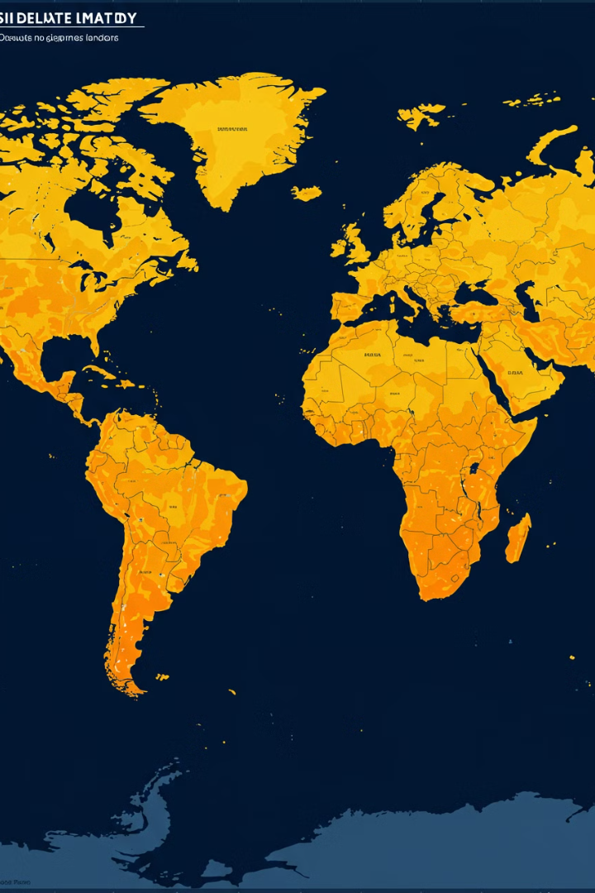
Enhanced Climate Predictive Accuracy
88%
Overall Accuracy
Across multiple European weather stations.
90%
Stable Climates
Accuracy in Oslo & Kassel due to consistent weather trends.

Slide 6
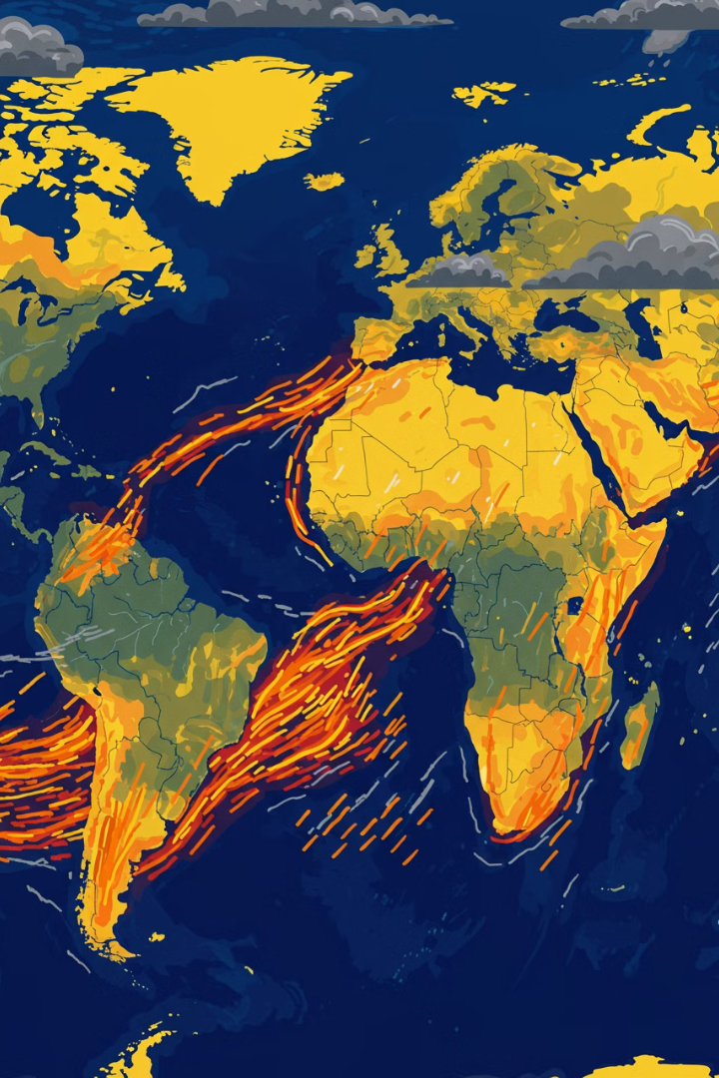
Improved Extreme Weather Forecasting
1
Heatwaves
2
Floods & Storms
Increased frequency & intensity were detected.
Higher occurrences were seen in certain regions.
3
Model Adaptation
Ongoing refinements are needed for unpredictable climates.

Slide 7
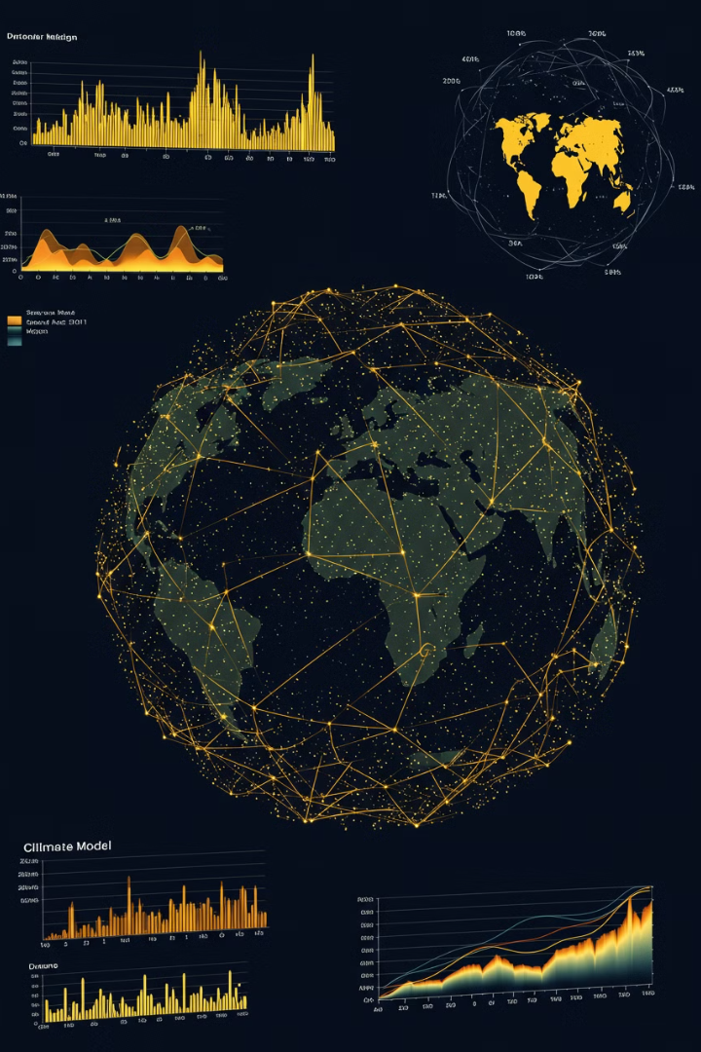
Future Enhancements & Recommendations
AI & Model Refinements
Global Data Expansion
Expand the dataset with global climate sources for increased generalization.
Implement ensemble learning & LSTM models for time-series climate predictions.
Continuous Training
Regularly update ML models with new climate patterns and fine-tune hyperparameters.

Slide 8
Conclusion
Machine Learning is transforming climate science. My AI-driven ClimateWins platform has enhanced forecasting and extreme event predictions.
Continued innovation, collaboration, and model refinement will drive better climate adaptation strategies worldwide.

Slide 9
Thank you

